Slide 1



VoiceBridge: Real-Time Speech Translation at the University of Arizona Final Project INFO – 511 SP25 By: Tanishk Singh Kanit Mann Coordinator: Dr. Angela Cruz
HackArizona’25

Slide 2
Outline
Project Inspiration and Overview
Key Features
How It Works
Technology Stack
Demo and Experience
Impact and Future

Slide 3

Project Inspiration and Overview
As international students, we experienced communication barriers firsthand in understanding Spanish—Tanishk while volunteering at Campus Pantry and Kanit when interacting with maintenance staff. When Google Translate failed, awkward silence followed.
These moments inspired us to create a real-time peer-to-peer AI based speech translation system, bridging language gaps and fostering meaningful connections across cultures and University campus.

Slide 4

FEATURES
Real-time Translation : Processes speech in small chunks for real-time translation
12+ Languages: Support for major world languages including English, Spanish, French, Chinese, Hindi, and more
Web-Based Interface: Works on any device with a modern browser
AI : Uses state of the art AI models (Whisper, NLB-200, MMS-TTS)
Context Maintenance: Preserves conversation context for coherent translation
Computationally Efficient : Uses multithreading to utilise CPU in absence of GPU

Slide 5
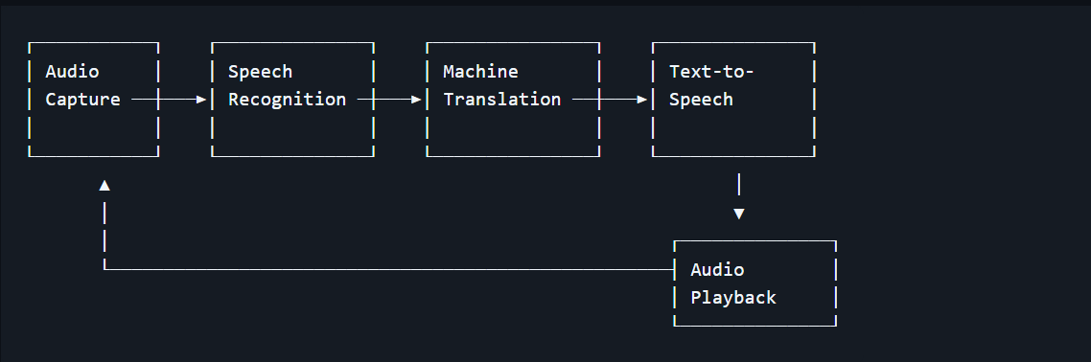
Architecture
VoiceBridge uses a modular pipeline architecture connecting three primary AI components:

Slide 6

How It Works
Audio Capture
Speech Recognition
Translation
The speaker’s voice is captured through device's microphone
Pre-trained model by Open AI for Automatic Speech Translation
The Speech is translated to the target language by Meta’s NLLB-200 model
.
Listener
Playback
Speech-Synthesis
Process repeats for listener.
The translated speech is played to the listener
Translated text is converted to speech by Meta’s MMS-TTS Model

Slide 7
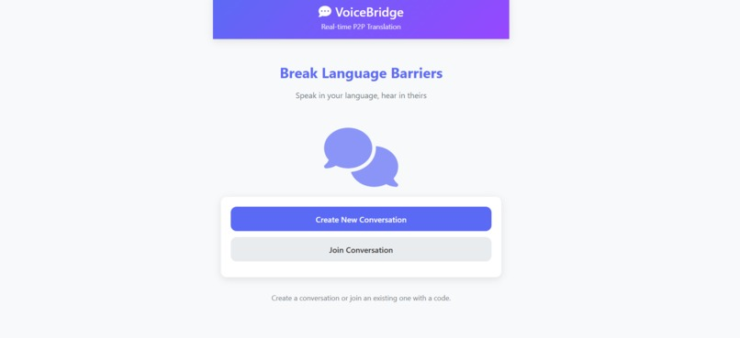
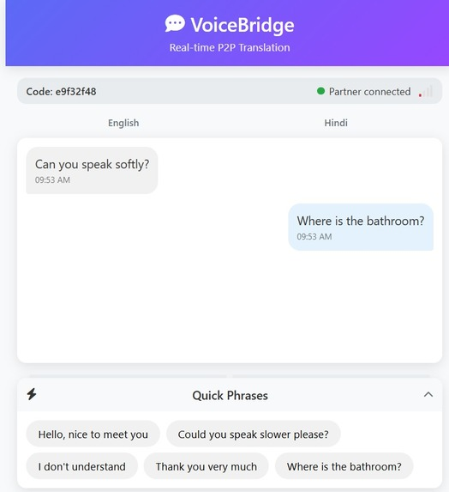
Project Gallery

Slide 8
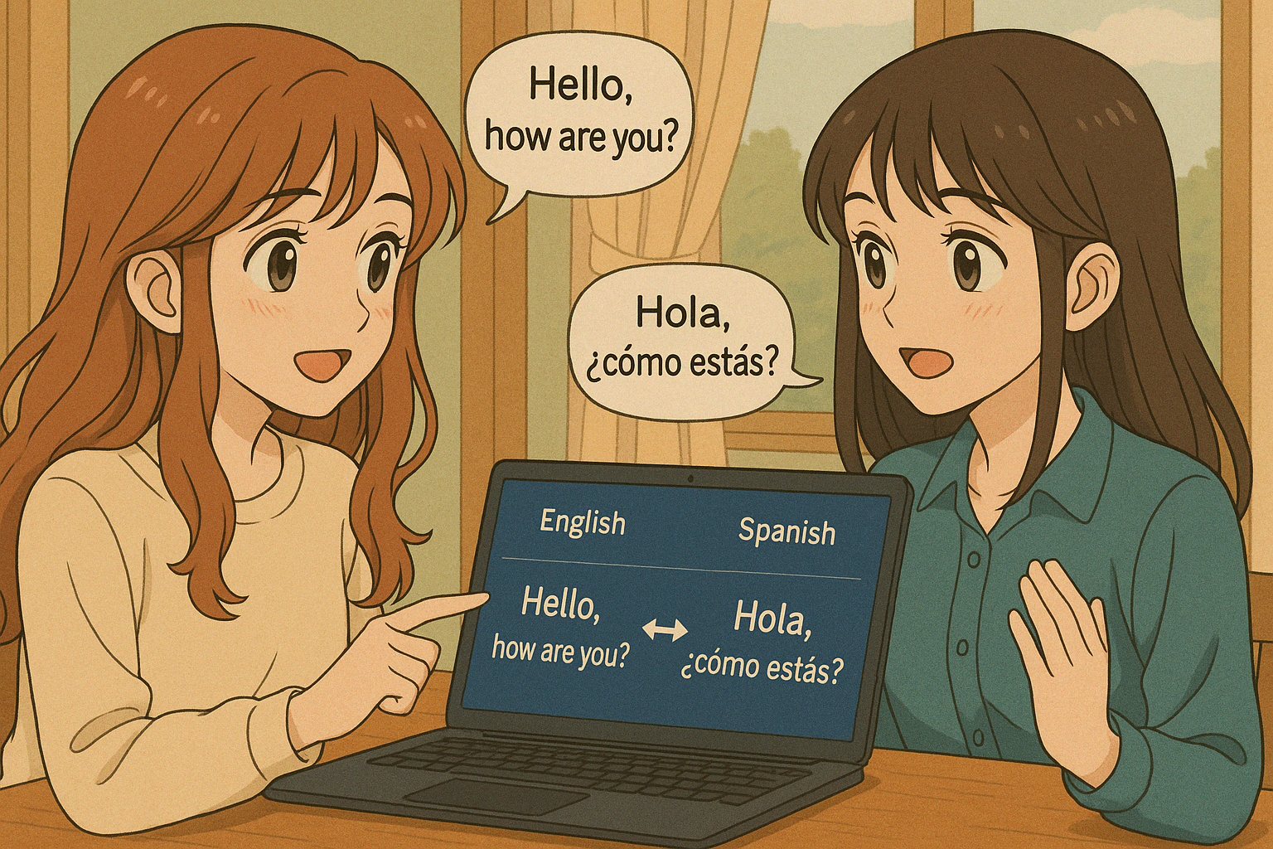
A near-perfect world for us!

Slide 9

Demo & Experience

Slide 10
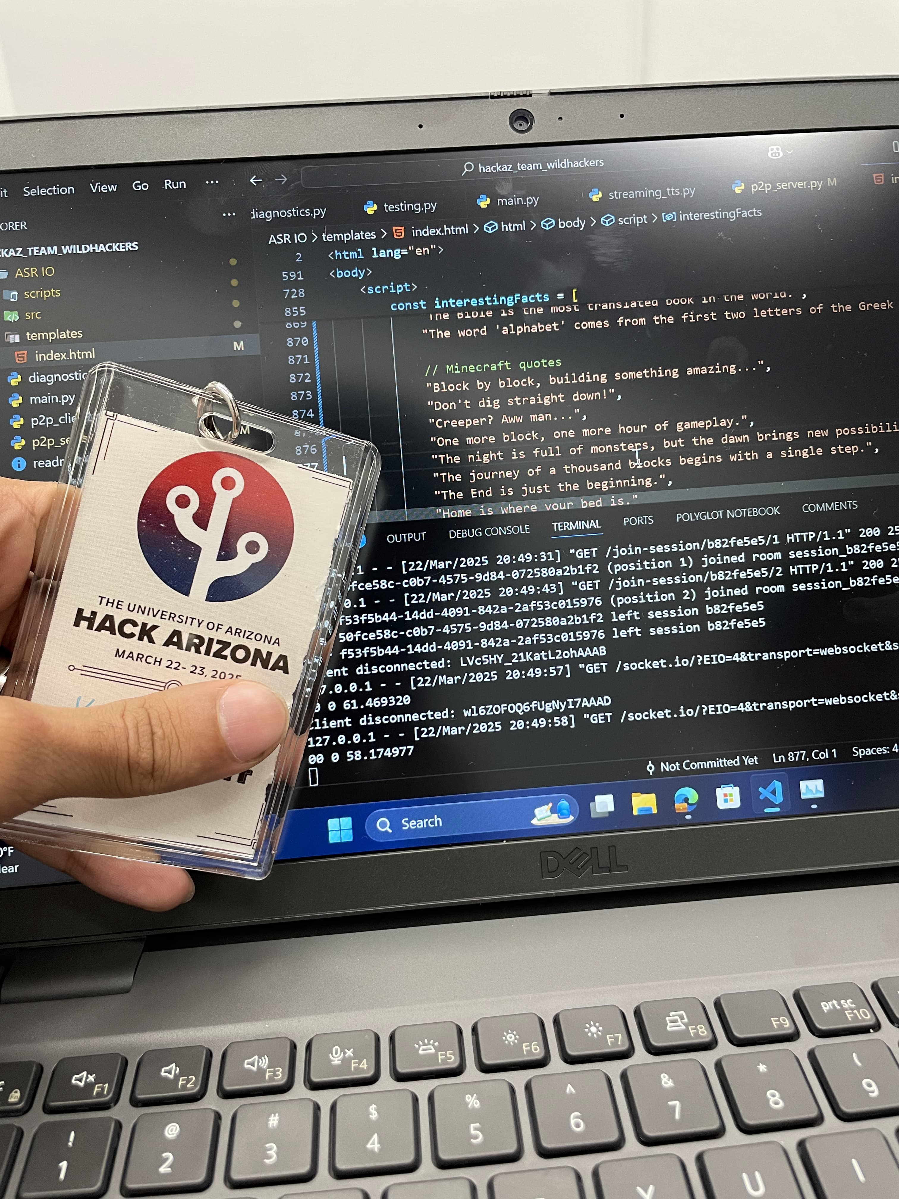

Code Features
GitHub Repository: https://github.com/kanitmann01/hackaz_team_wildhackers
Live Demo: https://kanitmann01.github.io/hackaz_team_wildhackers/
Devpost:
https://devpost.com/software/voicebridge-yc2aoi

Slide 11
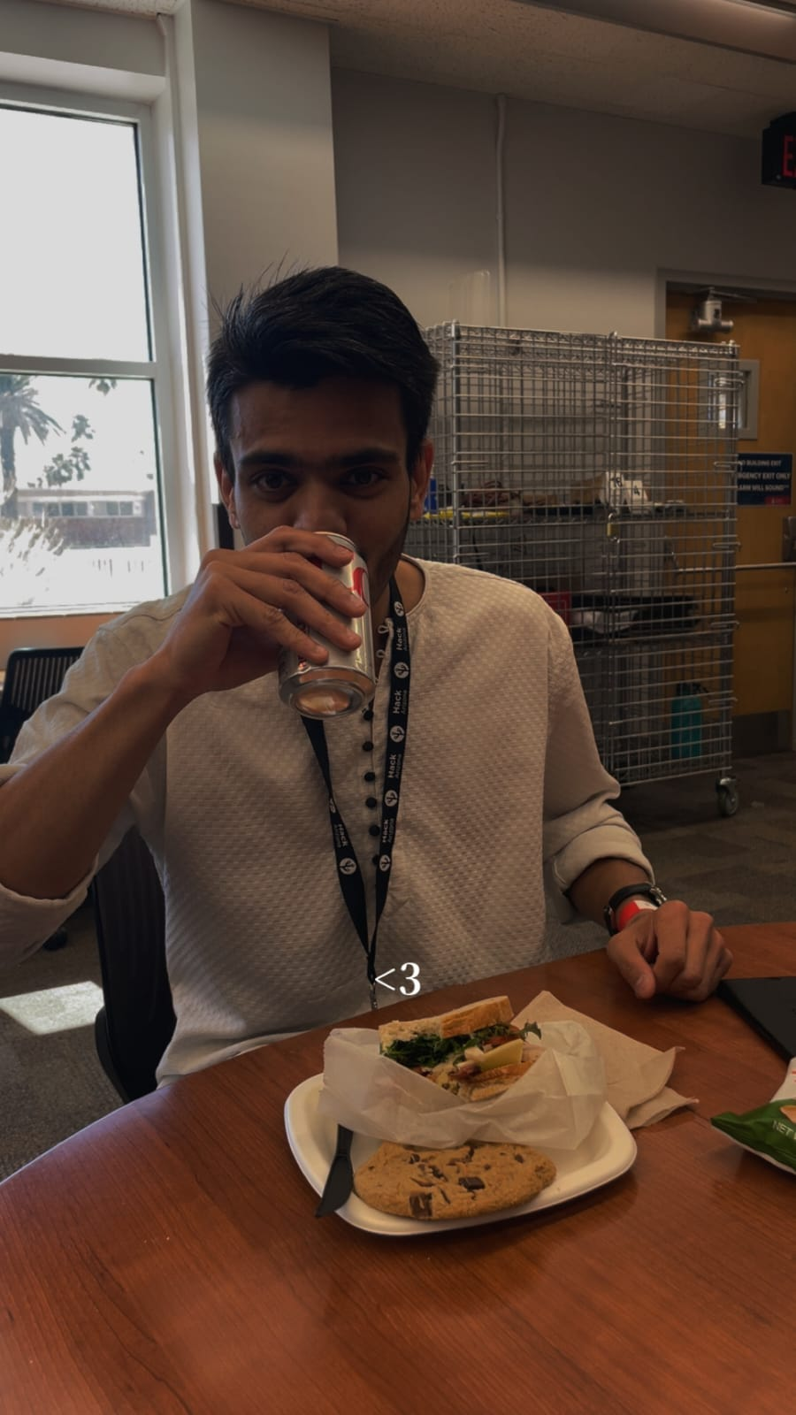
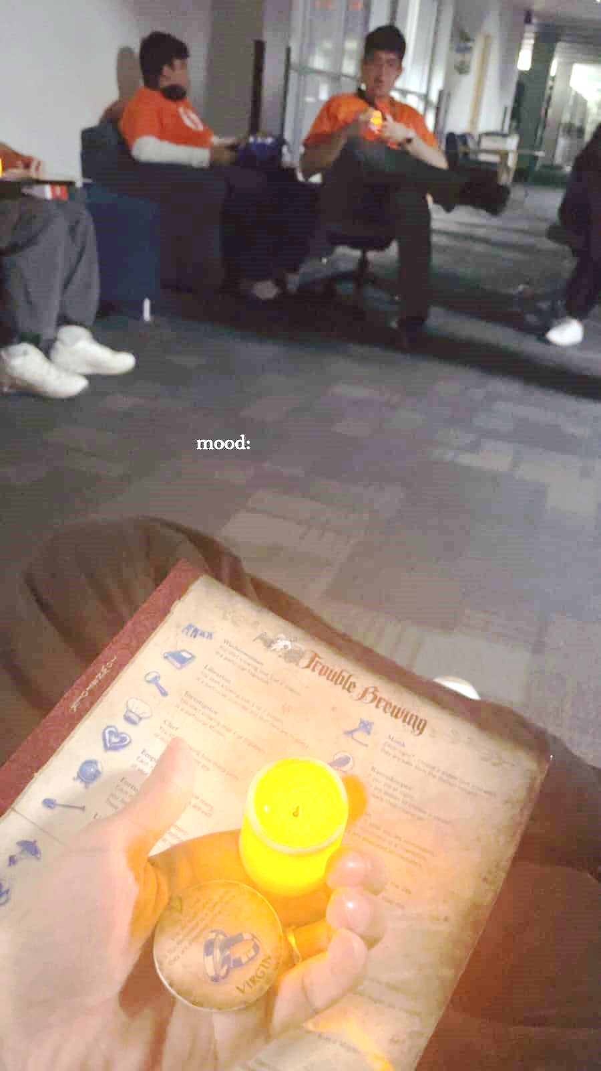
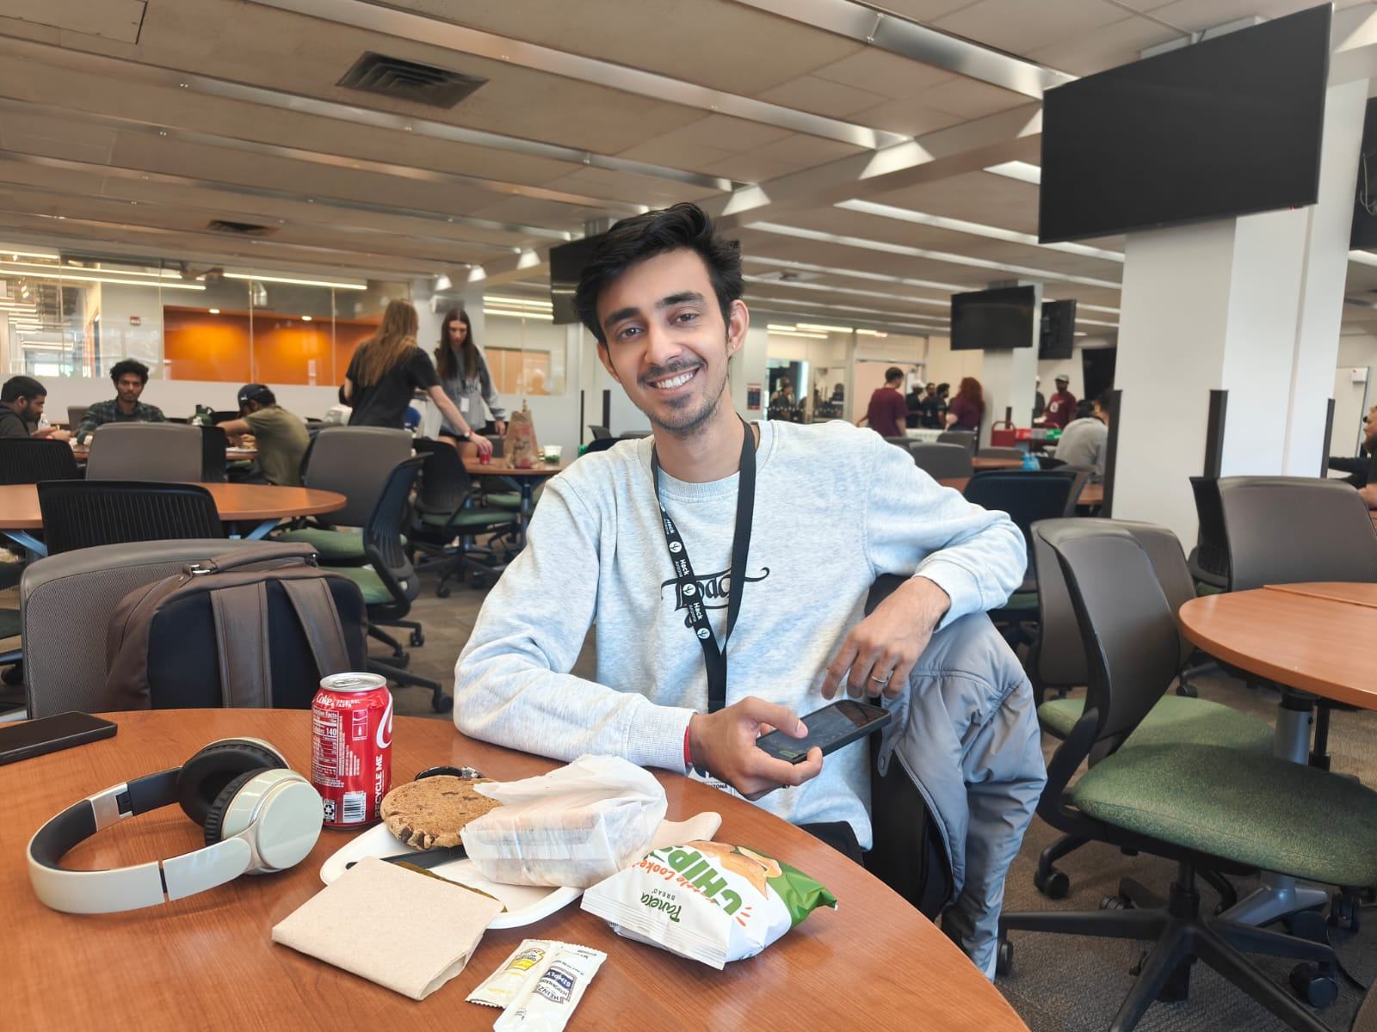
Side Quests
More Munching..
Thank You!
Munching..
Game Night!

